Slide 1


Cüneyt Erem
22.5.2023

Slide 2

Outline
Executive Summary
Introduction
Methodology
Results
Conclusion
Appendix

Slide 3
Executive Summary
We have collected data from both spacex api and wikipedia webpage. We used folium and dash graphical visualizations. We examined data with sql, then created four different machine learning models and compared accuracy scores.
Logistic regression, SVM, decision tree and KNN models have similar acuracy score above 80%, however most accurate score is 87% from decision tree.

Slide 4
Introduction
SpaceY is a company try to examine SpaceX company rocket landings and examine successful missions with exploring data science methodologies.
We want to apply four different machine learning models and compare accuracy scores, then plot graphs from data columns to dive into deep

Slide 5

Section 1

Slide 6
Methodology
Executive Summary
Data collection methodology:
Use spacex api and webscraping sikipedia page data
Perform data wrangling
Examine data with rocket launch specifications
Perform exploratory data analysis (EDA) using visualization and SQL
Perform interactive visual analytics using Folium and Plotly Dash
Perform predictive analysis using classification models
How to build, tune, evaluate classification models with logistic regression, svm, decision tree and knn algorithms

Slide 7
Data Collection
2 types of data collection behavior is applied such as retrieving from api and webscraping from Wikipedia page.
By retrieving spacex api data, we can get response data in JSON format. We collected data features like rocket, payloads, launchpad, flightnumber etc.
By using beautifulsoup package, we can websraping spacex wikipedia page and use find_all method to find specific table tabs. Then we can collect data features like rocket, payloads, launchpad, flightnumber etc. into dataframe.

Slide 8
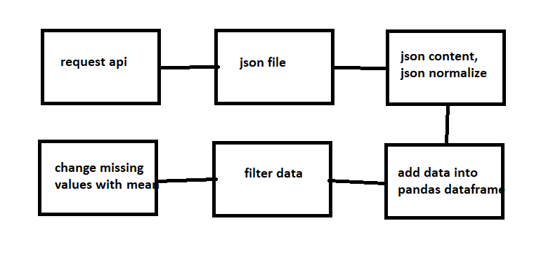
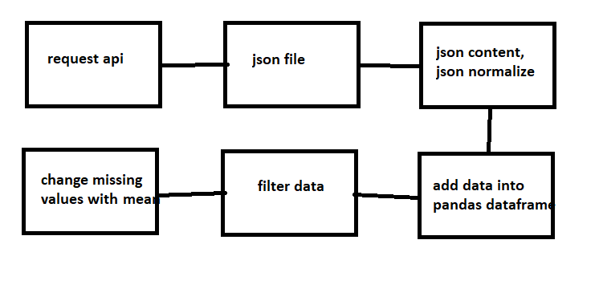
Data Collection – SpaceX API
https://github.com/cuneyterem8/certificate_projects/blob/main/ibm_data_science/11_applied_ds_capstone_project/1_jupyter-labs-spacex-data-collection-api.ipynb

Slide 9
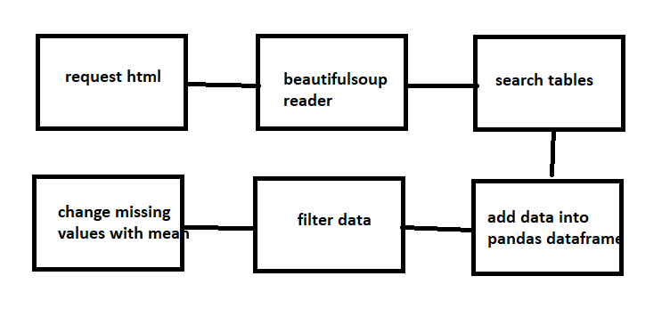
Data Collection - Scraping
Place your flowchart of web scraping here
https://github.com/cuneyterem8/certificate_projects/blob/main/ibm_data_science/11_applied_ds_capstone_project/2_jupyter-labs-webscraping.ipynb

Slide 10
Data Wrangling
After reading data with pandas dataframe, we examine data with counting number of null values for each columns from flightnumber to latitude.
We count number of launchsites, orbits, occurences of outcome, bad_outcomes and mean of class.
FlightNumber | Date | BoosterVersion | PayloadMass | Orbit | LaunchSite | Outcome | Flights | GridFins | Reused | Legs | LandingPad | Block | ReusedCount | Serial | Longitude | Latitude | Class
1 | 2010-06-04 | Falcon 9 | 6104.959412 | LEO | CCAFS SLC 40 | None None | 1 | False | False | False | NaN | 1.0 | 0 | B0003 | -80.577366 | 28.561857 | 0
https://github.com/cuneyterem8/certificate_projects/blob/main/ibm_data_science/11_applied_ds_capstone_project/3_labs-jupyter-spacex-data_wrangling_jupyterlite.jupyterlite.ipynb

Slide 11
EDA with Data Visualization
To see outcome of the launch, we can catplot flightnumber vs payloadmass
Ksc-lca-39a and vafb-slc-4e have 77% success rate so when flight number incerases, landing successful rate is also increases
Catplot for flightnumber vs launchsite is also applicable, if flight number > 40, it is more likely to land successfully
Catplot for launchsite vs payloadmass, if ccafs-slc-40 have more payload and ksc-lc-39a have less payload, then they are more likely to laúnch succesfully
Best orbits are es-l1, sso, heo and geo
Success rate increses over time and have highest point at 2020
https://github.com/cuneyterem8/certificate_projects/blob/main/ibm_data_science/11_applied_ds_capstone_project/5_jupyter-labs-eda-dataviz.ipynb.jupyterlite.ipynb

Slide 12
EDA with SQL
We find distinct launch sites, first 5 cca launch sites (ccafs-lc-40, vafb-slc-4e etc.), total payloadmass (45596 kg) by nasa and average payloadmass by f9-v1.1 (2534.66).
In 2014, first landing launch is become successful
There are four different booster versions which are successful and mass is betwen 4000-6000; f9-ft-b-1022, 1026, 1021.2 and 1031.2
Total succesful mission is 99 + 1 (unclear) and failure is 1
In 4 and 10th months, drone ship failures happened
Between 2010 and 2017, there are many count numbers for success, no attempt etc
https://github.com/cuneyterem8/certificate_projects/blob/main/ibm_data_science/11_applied_ds_capstone_project/4_jupyter-labs-eda-sql-coursera_sqllite.ipynb

Slide 13
Build an Interactive Map with Folium
After finding launch sites with longitudes and latitudes, we added circles and folium marken to the map on nasa coordinates.
We added yellow circle onto houston with circle (radius=1000) and popup
Then we make cluster with red and green marker colors and add onto map
Then we calculated distances between launch sites and closest coastlines by giving coordinates
https://github.com/cuneyterem8/certificate_projects/blob/main/ibm_data_science/11_applied_ds_capstone_project/6_lab_jupyter_launch_site_location.jupyterlite.ipynb

Slide 14
Build a Dashboard with Plotly Dash
We added drop-down interface with five launchsite names by option menu on top of the screen
We modified success-pie-chart with total success rate for each class and with selected cites option
Rangeslider is added with three options from 0 to 10,000 kg
Scatter chart is created with payloadmass vs class columns for min/max payload capacity
https://github.com/cuneyterem8/certificate_projects/blob/main/ibm_data_science/11_applied_ds_capstone_project/7_spacex_dash_app.py

Slide 15
Predictive Analysis (Classification)
The independent data (column: class) is assigned to Y and dependent variables are assigned to X
We used standard scaler and transformed each X variable, then splitted train and test data with 0.2 test size and random state 2
We used four different models with different parameters; these are logistic regression, SVM, decision tree and KNN classifiers. We created confusion matrix for each of them and applied gridsearch to find best parameters for each model.
https://github.com/cuneyterem8/certificate_projects/blob/main/ibm_data_science/11_applied_ds_capstone_project/8_SpaceX_Machine_Learning_Prediction_Part_5.jupyterlite.ipynb

Slide 16
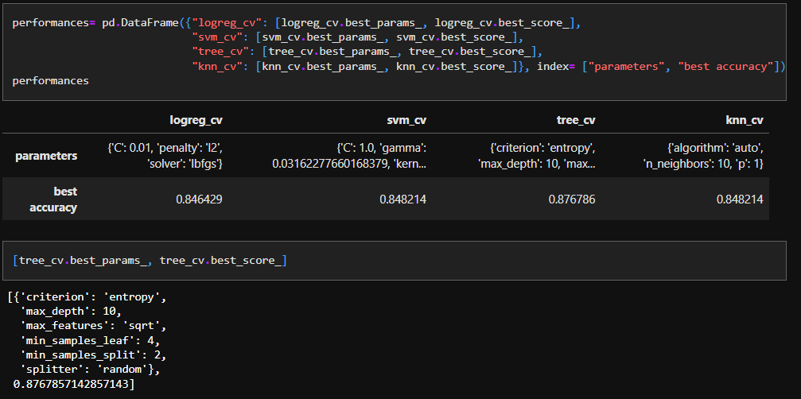
Results
The best result is decision tree with 87% accuracy score, details can be seen here;

Slide 17

Section 2

Slide 18
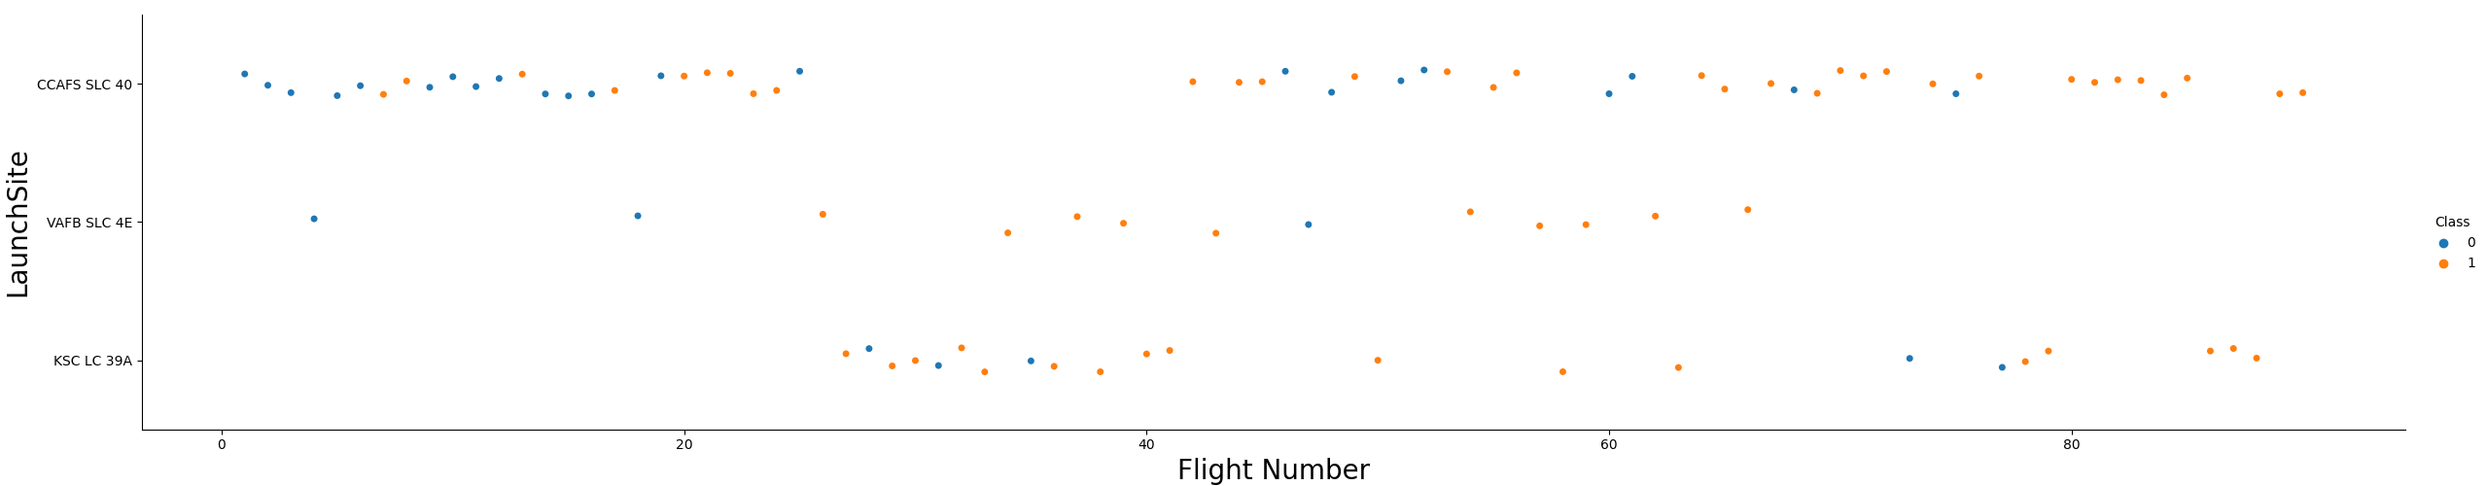
Flight Number vs. Launch Site
If flight number increases, success rate is also increases for 3 launchsites

Slide 19
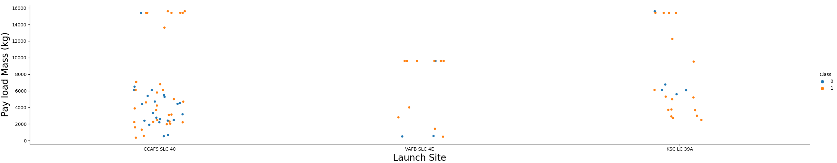
Payload vs. Launch Site
If launch site is ksc-lc-39a and payload mass is high, then success increases

Slide 20
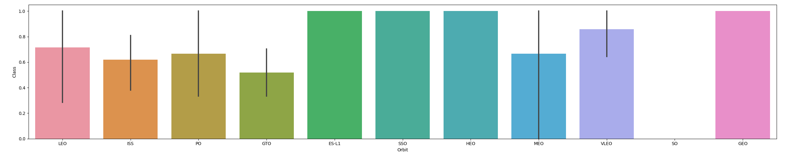
Success Rate vs. Orbit Type
Most successful orbits are as-l1, ssc, heo and geo with their types

Slide 21
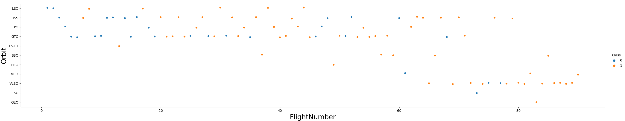
Flight Number vs. Orbit Type
Overall, if flight number increases, success rate increases for different orbits

Slide 22
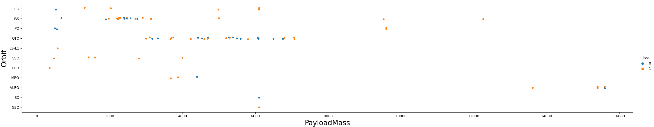
Payload vs. Orbit Type
Geo: it does not changefor payload
Sso, heo, leo, iss: mostly successful for each payload
Meo, so: if payload increases, success rate decreases

Slide 23
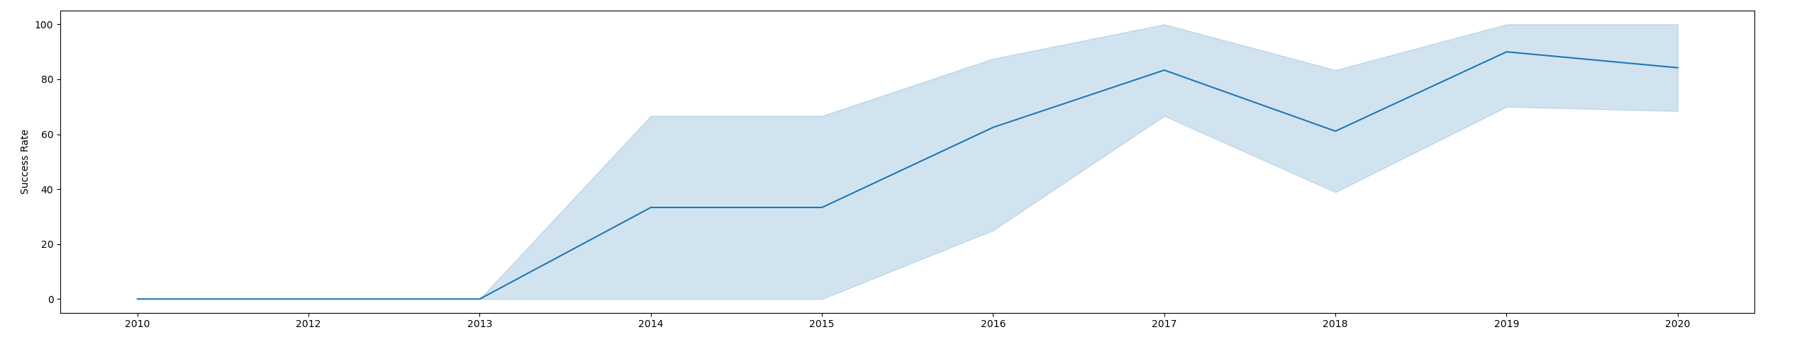
Launch Success Yearly Trend
It can be clearly seen that success rate increases over time, only exception is year 2018 and small decrease in 2020

Slide 24
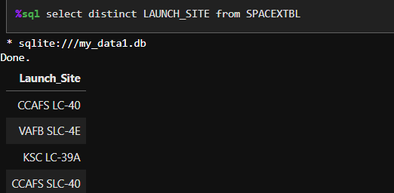
All Launch Site Names
There are four distinct launch names as written above

Slide 25
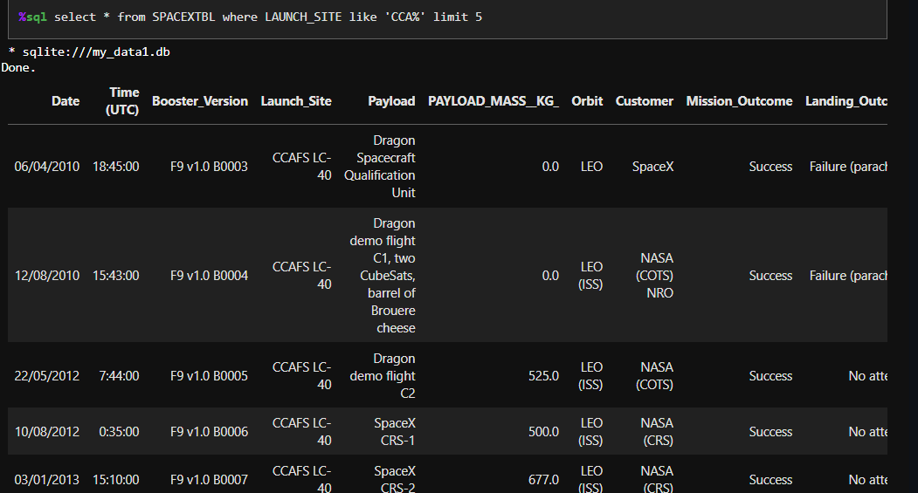
Launch Site Names Begin with 'CCA'
CCA like launchsites have different orbits and customers as can be seen right side

Slide 26
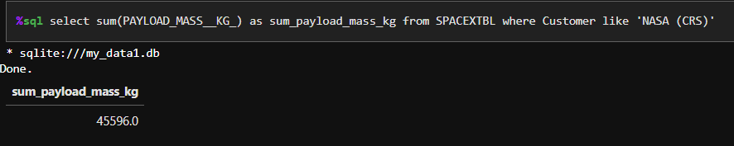
Total Payload Mass
Nasa used total payload of 45596 kg

Slide 27
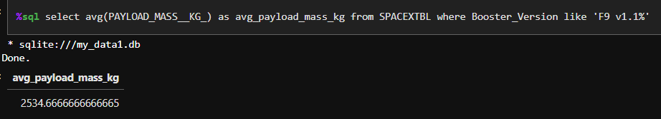
Average Payload Mass by F9 v1.1
Average payload is 2534.66 for F9-v1.1

Slide 28
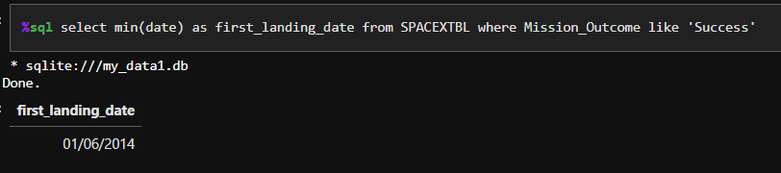
First Successful Ground Landing Date
First successful landing is happened in 2014

Slide 29
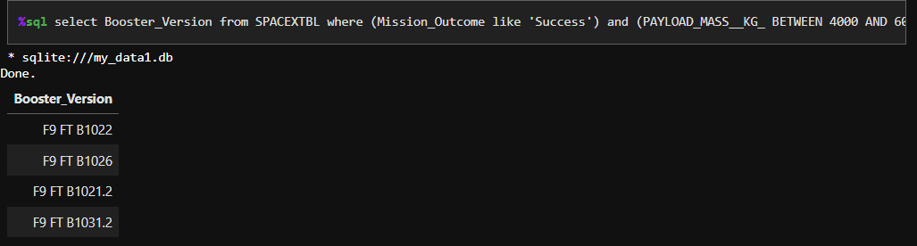
Successful Drone Ship Landing with Payload between 4000 and 6000
There are four different booster version which were successful

Slide 30
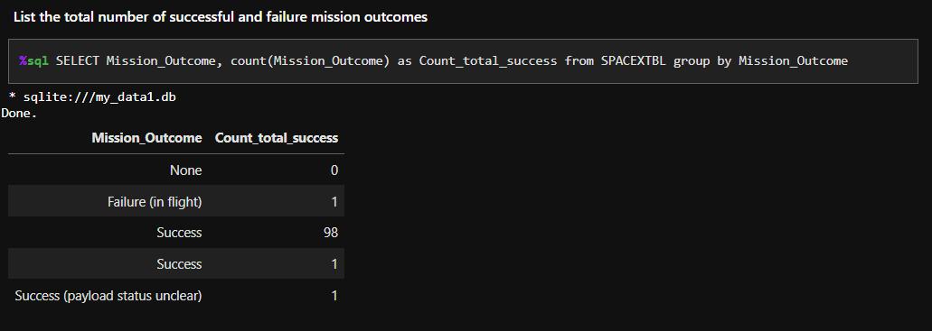
Total Number of Successful and Failure Mission Outcomes
There are 100 success and 1 failure mission outcome

Slide 31
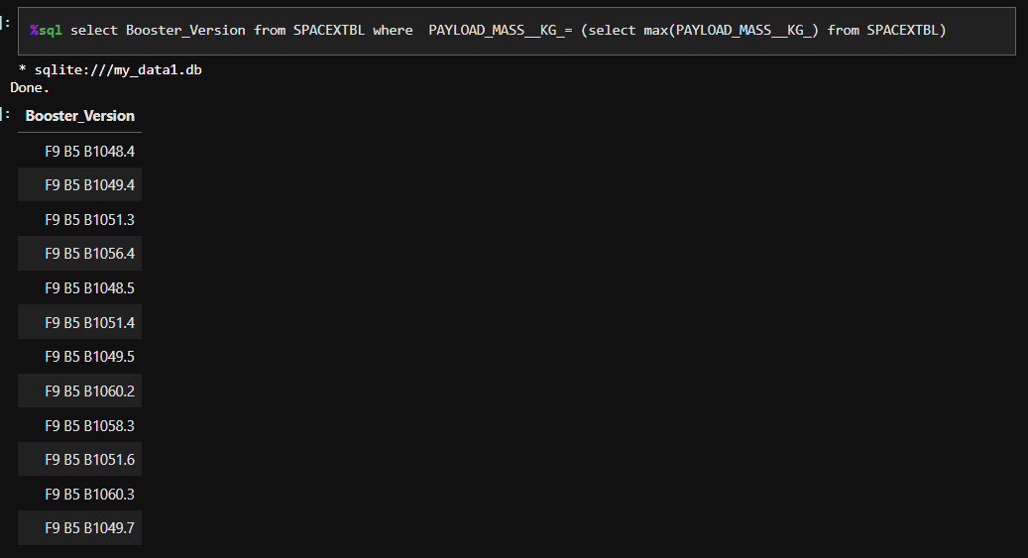
Boosters Carried Maximum Payload
In total, there are 12 booster versions with maximum payloads

Slide 32
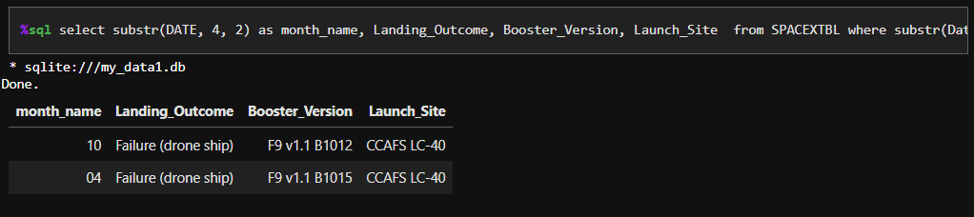
2015 Launch Records
Drone failures are at 4 –th and 10-th months for f9-v1.1

Slide 33
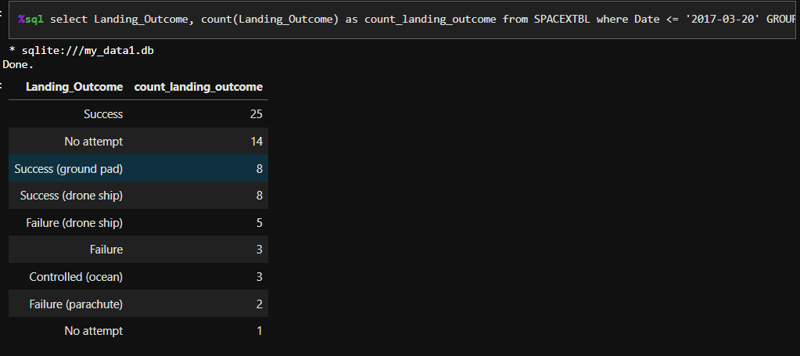
Rank Landing Outcomes Between 2010-06-04 and 2017-03-20
Success is 25, no attempt is 14 and there are other success and failure as above

Slide 34

Section 3

Slide 35
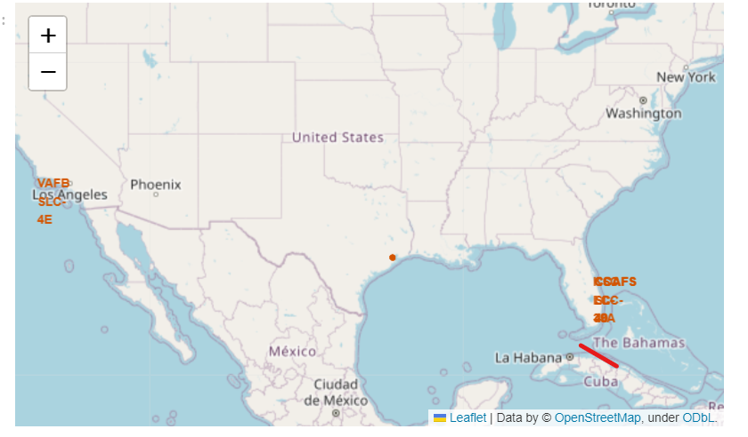
<Folium Map Screenshot 1>
By adding circles and markers, we can identify 2 launch sites on the map

Slide 36
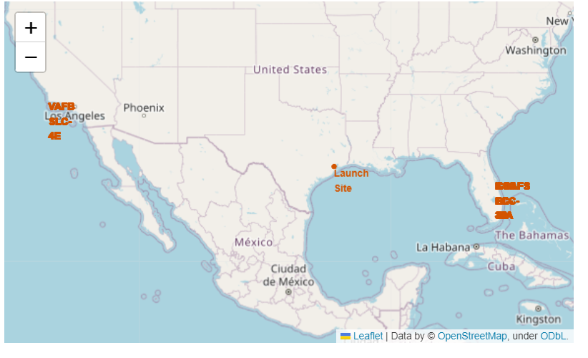
<Folium Map Screenshot 2>
We can identify classes red or green if successful or not

Slide 37
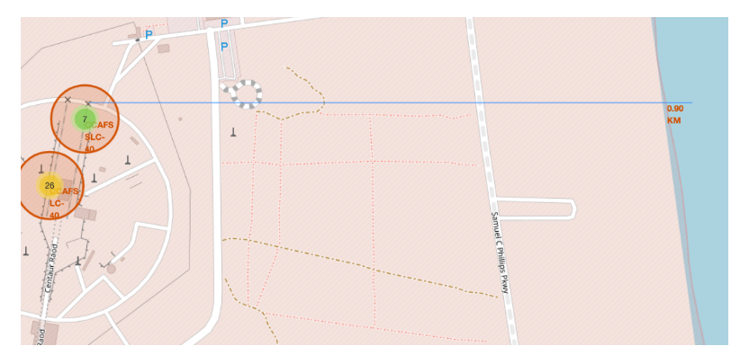
<Folium Map Screenshot 3>
We can calculate distance from center to nearest coastline

Slide 38

Section 4

Slide 39
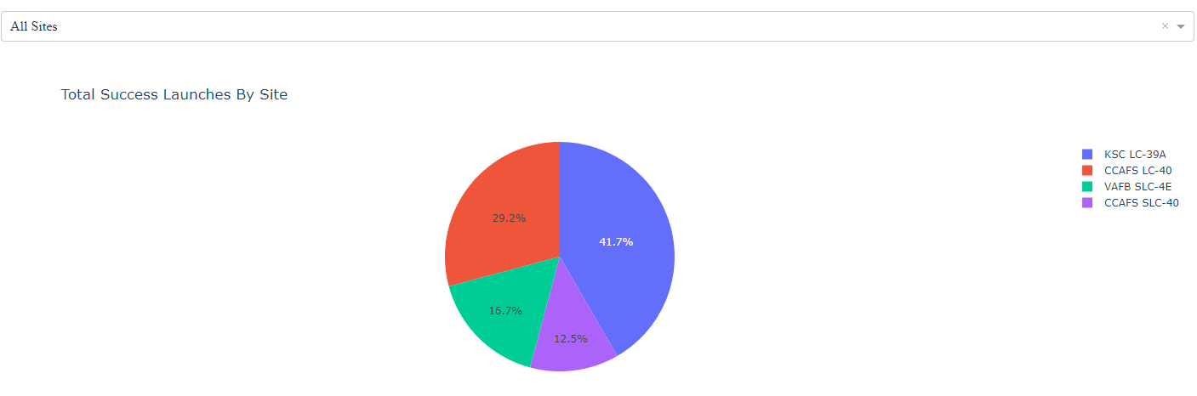
<Dashboard Screenshot 1>
The four launches from different sites can be seen as above.

Slide 40
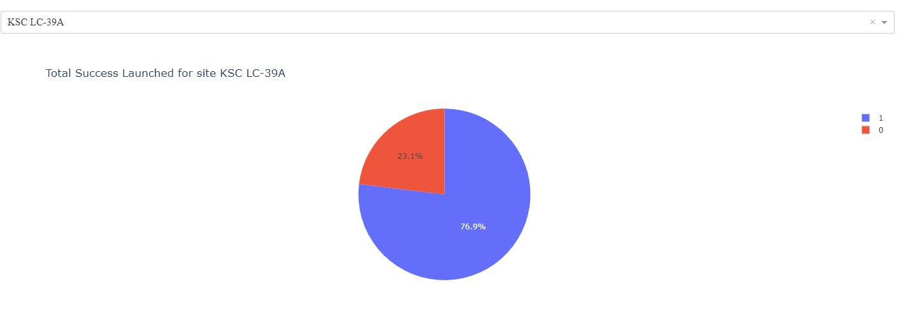
<Dashboard Screenshot 2>
Highest rate is kcl-lc-39a as 76,9%

Slide 41
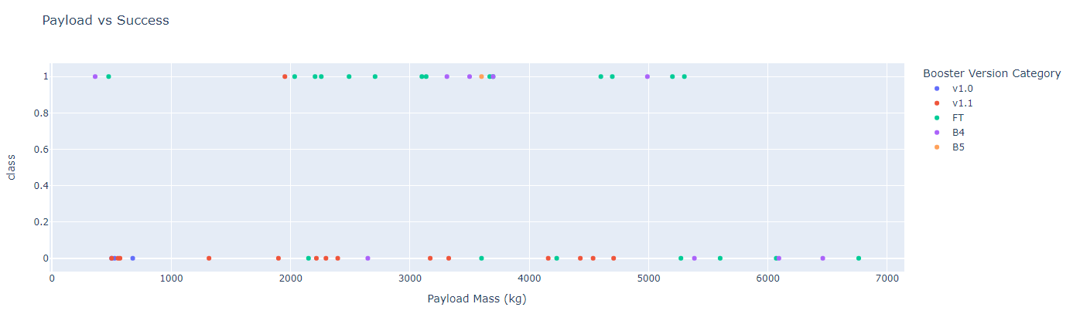
<Dashboard Screenshot 3>
Payload vs success rate can bwe seen as above, v1.0 has highest success rate

Slide 42

Section 5

Slide 43
Classification Accuracy
Four model accuracy scores are defined as above

Slide 44
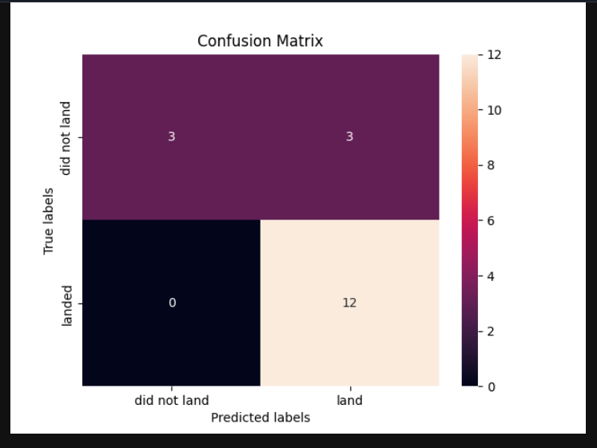
Confusion Matrix
TP: 3, TN: 12, FP: 3, FN: 0
So, the accuracy rate for overall performenca is 83.3%

Slide 45
Conclusions
We have gathered information from both SpaceX API and a Wikipedia webpage. Our visualizations utilized Folium and Dash for graphical representation. The data was analyzed using SQL, and subsequently, we developed four distinct machine learning models to assess their accuracy scores.
The logistic regression, SVM, decision tree, and KNN models all demonstrated comparable accuracy scores exceeding 80%. Among them, the decision tree model achieved the highest accuracy score of 87%, making it the most precise.

Slide 46
Appendix
[1]https://github.com/cuneyterem8/certificate_projects/tree/main/ibm_data_science/11_applied_ds_capstone_project
[2]https://www.coursera.org/learn/applied-data-science-capstone/home/week/5

Slide 47


